Slide 1


This presentation consists of SAIC general capabilities information that does not contain controlled technical data as defined by the International Traffic in Arms (ITAR) Part 120.10 or Export Administration Regulations (EAR) Part 734.7-11.
Treadstone + 1:
The First Anniversary of the SAIC Digital Engineering Validation Tool
Michael J. Vinarcik, ESEP-Acq, P.E., FESD Chief Systems Engineer
SAIC Strategy, Growth, and Innovation Organization (Digital Engineering)
www.incose.org/iw2021/
MBSE
Lightning
Round

Slide 2

Status Quo:
Document-Intensive SE
Leads to siloed, disconnected views of a system
No guarantee of consistency
between requirements or views
Often delivered as PDFs, Excel, or other disjointed artifacts
Difficult to review thoroughly
A coherent picture is difficult to assemble!
MBSE
Lightning Round
3

Slide 3
How Modeling Can Help
MBSE
Lightning Round

Slide 4
Lessons Learned and Recommended Best Practices
from Model-Based Systems Engineering (MBSE) Pilot Projects
Ryan Noguchi, Aerospace Corporation (2016)
The Ability to Interrogate the Data:
“The modeling tools provide mechanisms for users to query the model to navigate this “mesh” of elements, attributes, and relationships to obtain more focused slices of insight into the architecture of the system.”
An Increased Focus on Content/Data:
“Stakeholders and practitioners often did not understand the implications of this new approach, or take advantage of the benefits it can provide.”
Automated Reviews:
“…many syntactical errors that would have been caught had they used the built-in model validation capabilities of their tools, but the problem would also have been apparent upon visual inspection by an experienced modeler…it is critical that model reviews be performed frequently by experienced modelers, particularly to check for semantic mistakes—those that won’t be caught by the modeling tools’ validation checks… Model reviews performed in a briefing format or through static captures of the model (typically via PDF files or HTML files) are much less effective at ferreting
out errors.”
MBSE
Lightning Round
5

Slide 5
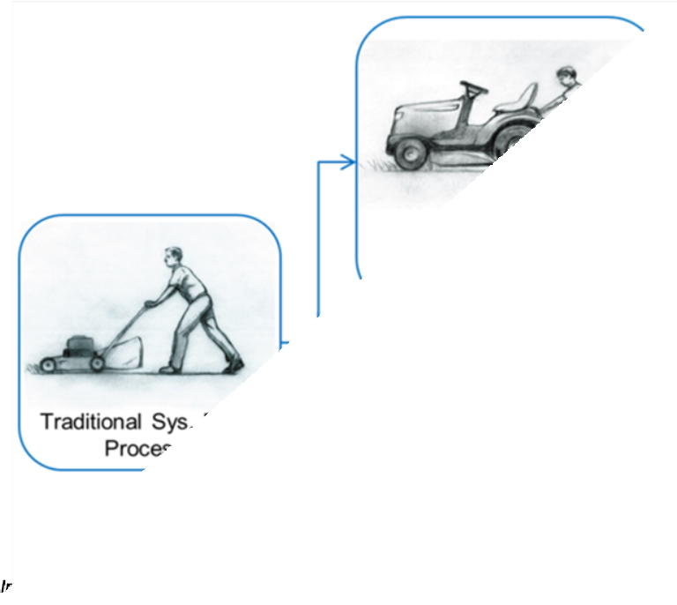
Our Challenge: MBSE Missteps
MBSE efforts stall because they fail to grasp the opportunities inherent in the new approach
Confounding the outcome with
the means
Excessive focus on diagrams/views vs. data
Models can be more consistent and coherent…but it takes skill and effort to achieve that end
MBSE
Lightning Round
6

Slide 6
SAIC’s SysML Modeling Style
MBSE
Lightning Round

Slide 7
SAIC’s SysML Modeling Style and Pragmatism
“…this involves a willingness to trade off theoretical purity or future perfection in favor of getting things done today.” p. 26
“…a willingness to experiment and be proven wrong.
This means we try stuff. We fail.
Then we use the lessons from that failure in the next experiment.” p.27
Apprenticeship Patterns: Guidance for the Aspiring Software Craftsman (2009) _{MBSE}
David H. Hoover & Adewale Oshineye. O’Reilly Media
Lightning Round
8

Slide 8
SAIC’s SysML Modeling Style
Focused on the integration of behavior and structure through the creation of well-formed blocks:
Behaviors
Operations (what functions the block can do) + Parameters (inputs/outputs of each function)
State machine (what the block does under various conditions)
Structure
Part properties defining its components
Proxy ports defining what can flow into/out of the block
Internal block diagram (optional)
Item flows / flow sets defining flows into/within the block’s structure
Attributes
Value properties defining characteristics of interest
The focus on operations as the atomic behavioral element eliminates ambiguity (1:1 ownership) and facilitates metachain queries.
The use of signals as conveyed elements, inputs/outputs (parameters), and triggers
enables a richer understanding of system behavior than traditional functional
MBSE
decomposition.
Lightning Round
9

Slide 9
SAIC’s SysML Modeling Style
Limited to a subset of SysML:
All ports are proxy ports
Reference properties, allocations, and swimlanes are prohibited
Item flows are used to integrate behavioral and structural views
A minimal set of customizations is used:
<<logical>> and <<physical>> stereotypes are used to separate abstraction levels
<<flow set>> customizations allow the linking of deeply nested parts/ports
The style focuses on usage and inferences from usage, not manual creation of
relationships:
Example 1: Calling an operation on an activity diagram allows the inference that the block that owns the operation participates in the activity
Example 2: Realizing an object flow with an item flow establishes the source/target port (so send and accept events can infer ports and parts)
Example 3: The calling of operations in state do/entry/exit or transition behaviors allows
inference of what states/transitions are able to support mission threads (activities)…or the
impact of failures
MBSE
Lightning Round
1
0

Slide 10
SAIC’s Digital Engineering Validation Tool
MBSE
Lightning Round

Slide 11
SAIC Digital Engineering Validation Tool
Shipshape and Bristol Fashion: Model Documentation and Curation to Facilitate Reuse (Vinarcik/Jugovic, 2019 NDIA Systems and Mission Engineering Conference) discussed the use of automated validation in systems modeling: “When a model passes validation, you KNOW it is compliant…Validation is fast and consistent, Seconds/Minutes vs. Hours”
SAIC released its Digital Engineering Validation Tool in December 2019:
V1.0 (December 2019—126 rules):
Initial customizations
Videos
– V1.5 (April 2020—153 rules)
Model-based Style Guide
Example model (Ranger lunar probe)
Rhapsody rules
– V1.6 (August 2020—164 rules)
MBSE
Lightning Round
Classification/Data Rights customization
V1.7 (January 2021—184 rules)
FMEA customization

Slide 12
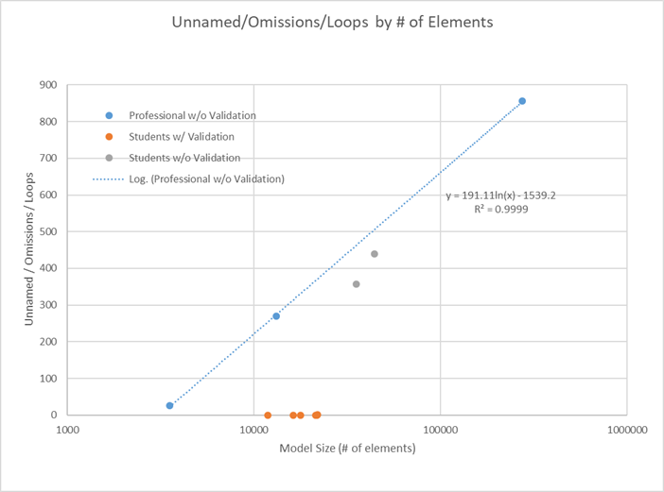
2020 ASEE Paper:
Treadstone: A Process for Improving Modeling Prowess Using Validation Rules
MBSE
Lightning Round

Slide 13
Classification / Data Rights Profile FMEA Profile
MBSE
Lightning Round

Slide 14
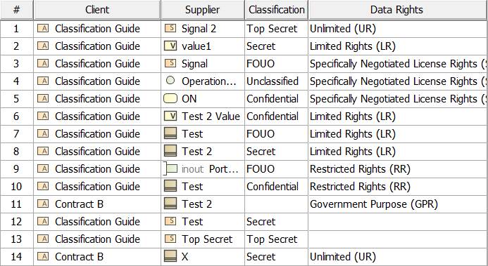
SAIC Classification Profile: Restriction Relationships
MBSE
Lightning Round

Slide 15
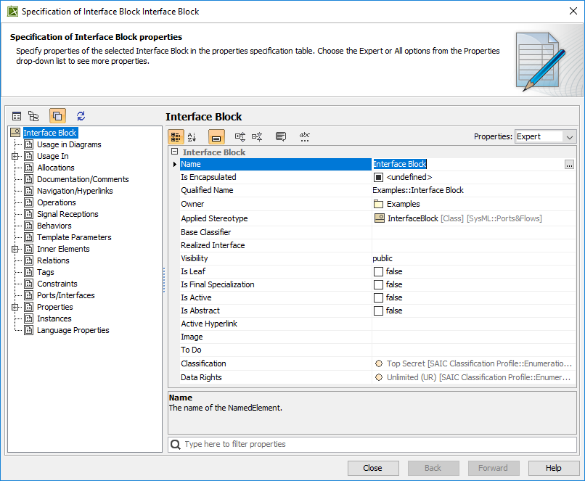
SAIC Classification Profile:
Inherent Classification/Data Rights Properties
MBSE
Lightning Round

Slide 16
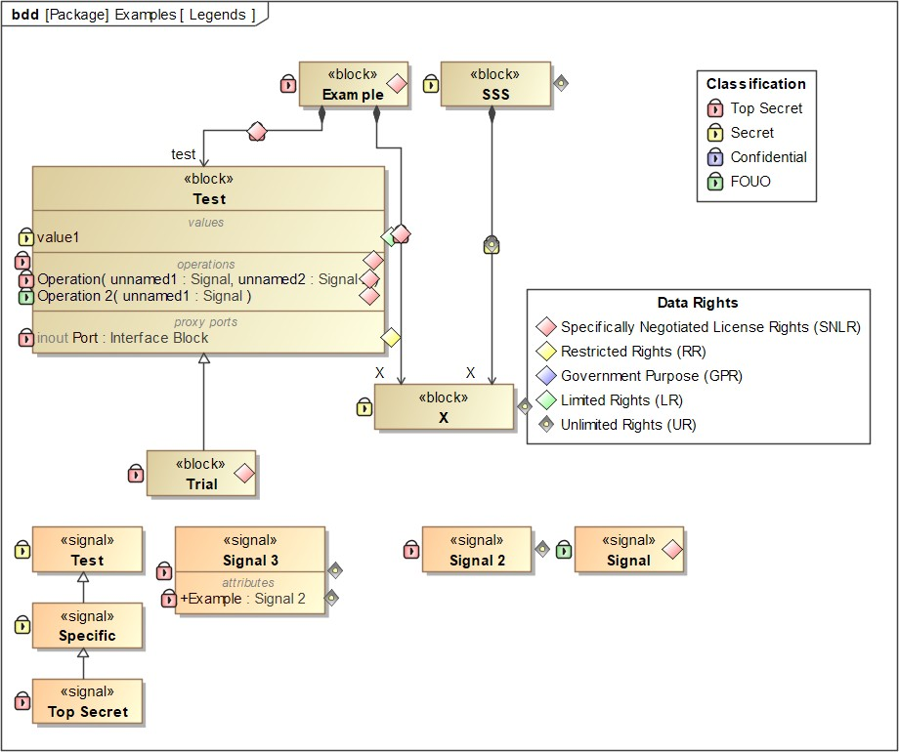
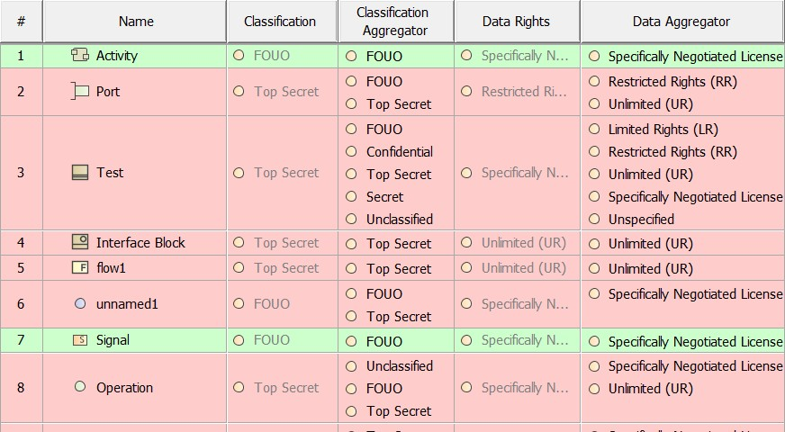
SAIC Classification Profile
MBSE
Lightning Round

Slide 17
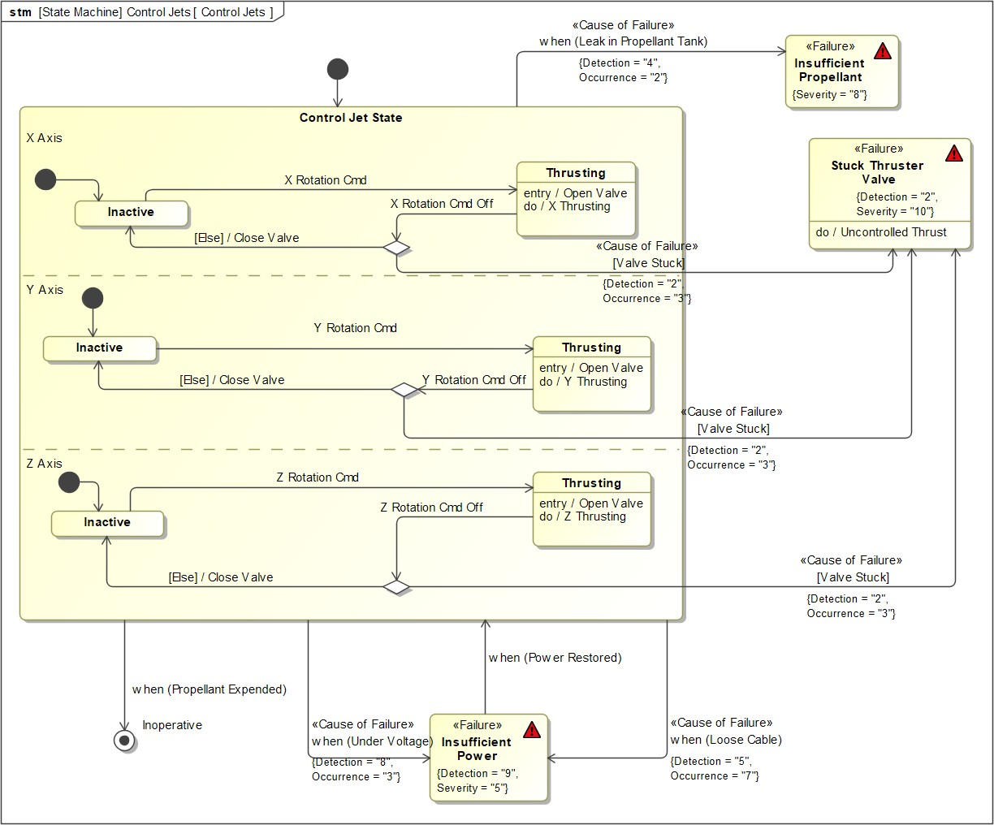
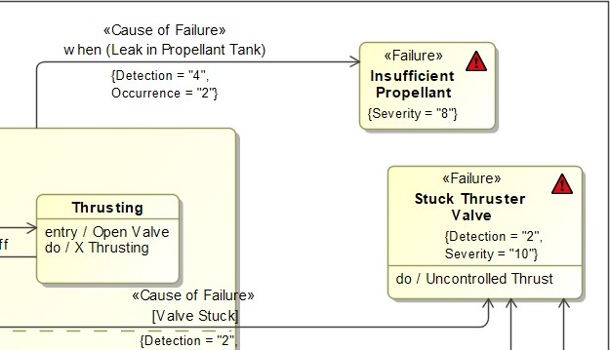
SAIC FMEA Profile
MBSE
Lightning Round

Slide 18
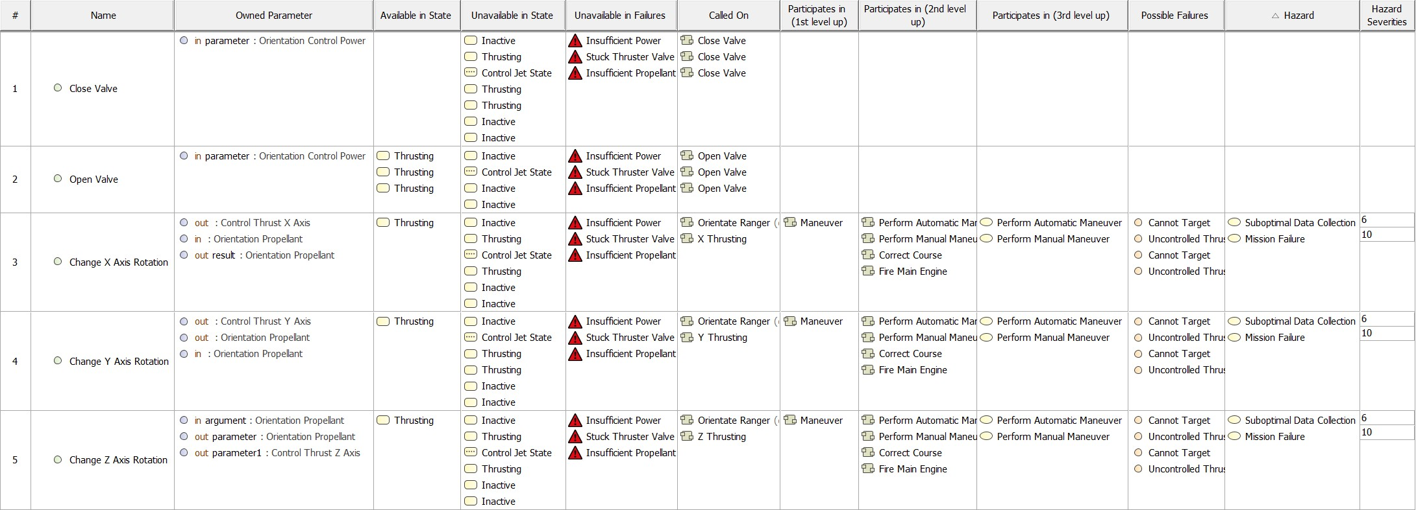
SAIC FMEA Profile:
State and Mission-Thread Driven Analysis
MBSE
Lightning Round

Slide 19
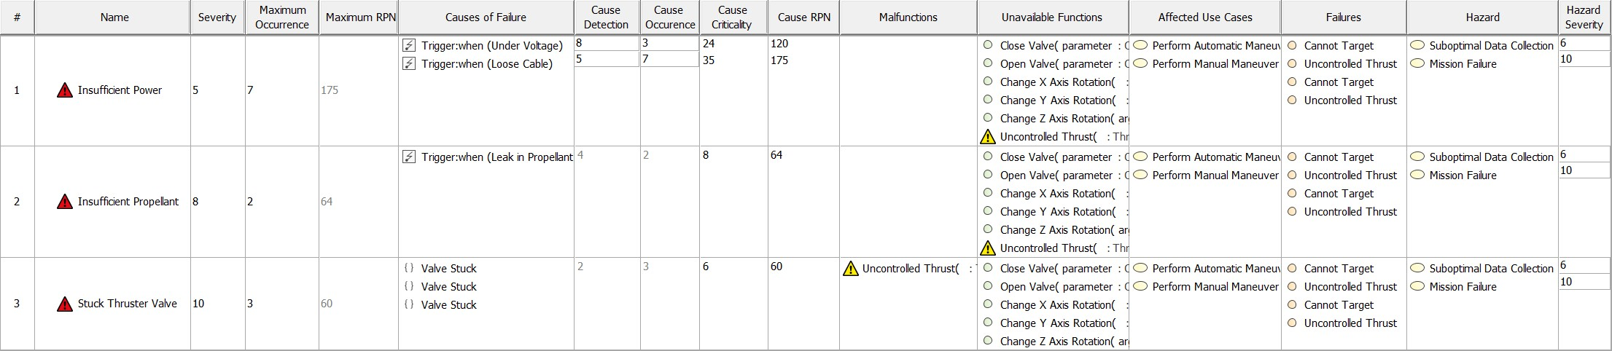
SAIC FMEA Profile: Automatic RPN Calculation
MBSE
Lightning Round
2
0

Slide 20


From Treadstone: A Process for Improving Modeling Prowess Using Validation Rules
2020 American Society for Engineering Education Annual Conference
Teaching SysML Modeling
at the University of Detroit Mercy
MBSE
Lightning Round

Slide 21
Pedagogy of the SysML Modeling Class at UDM
Phase I:
Construction of small models
Creation of simple diagrams
Experience with collaboration on
TeamWork Cloud
Phase II:
Collaborative modeling of representative systems
Focused on experiencing the subtleties of working together on a large system model
Showcases best practices for collaboration
Cultivates a visceral understanding of how modeling tools work and how to make a model serve a systems engineering effort
Past topics for Phase II include notional
“System modeling is not a conceptually simple or
straightforward task…building models using these tools is not always straightforward, and like software programming, is a skill that not everyone can learn equally well.”
R. A. Noguchi, Lessons Learned and Recommended Best Practices from Model-Based Systems Engineering (MBSE) Pilot Projects, Aerospace Corporation, 2016
nuclear submarines, next generation
MBSE
Mars orbiters, and simulated Mars roveLrsig.htning
Round

Slide 22
Managing Phase II
Classroom sessions are suspended, and a laboratory format is adopted
Weekly meetings are conducted with each team
Answer questions
Recommend next steps
Shepherd the team to completion
Instructor serves as a senior modeler/reviewer for each team
Excessive time spent on semantic issues and method deviations
Less time available for focusing on the intellectual content
MBSE
Lightning Round

Slide 23
Pre-Release Digital Engineering Validation Tool
A pre-release version of the Digital Engineering Validation Tool was used during the Fall 2019 term.
This allowed encoding of the instructor’s knowledge/review process and enabled rapid grading/review of assignments.
Model errors that “leaked” past rules spawned new rules.
Automation is important:
21 students Fall 2019
40 students Fall 2020
MBSE
Lightning Round

Slide 24
2019 Topic: Mars Society University Rover Challenge
College competition run by the Mars Society (includes testing in Utah desert)
2020 challenge consisted of 79 requirements and these milestones:
Preliminary Design Review (PDR)
System Acceptance Review (SAR)
Science Plan
36 teams passed SAR (competition cancelled due to COVID-19)
How complete were the requirements?
MBSE
Lightning Round

Slide 25
Requirements Count / Increase By Team
Team | Initial | Final | % Increase
Curiosity | 76 | 205 | 170%
JARS | 76 | 216 | 184%
Strike Force Alpha | 76 | 142 | 87%
Team Bolt | 76 | 172 | 126%
Team Chimps | 76 | 284 | 274%
Team Voodoo | 76 | 110 | 45%
Growth driven by use of extended requirement types and two rules: all requirements must be satisfied and verified.
MBSE
Lightning Round

Slide 26
Fall 2019 Model Size vs. Checkpoint
 | Model Elements |  |  |  | Validation
Team | Initial | Checkpoint | Final | End of Term | Errors | Info | Pages
Curiosity | 8,587 | 22,550 | 17,588 | 21,483 | 0 | 0 | 198
JARS | 9,548 | 16,291 | 18,357 | 21,905 | 1 | 214 | 237
Strike Force Alpha | 7,070 | 8,963 | 13,351 | 16,204 | 0 | 0 | 193
Team Bolt | 8,,262 | 19,440 | 15,206 | 17,773 | 0 | 39 | 199
Team Chimps | 10,015 | 22,050 | 18,732 | 21,768 | 0 | 0 | 242
Team Voodoo | 5664 | 8,583 | 9,846 | 11,836 | 0 | 76 | 175
Note: The ruleset grew from 72 rules at kickoff to 127 rules at completion Rules instability led to rework in addition to model maturation/growth
MBSE
Lightning Round

Slide 27
Fall 2020: Mars Octet
Federated model used to integrate eight individual models:
Collection Rover
Retrieval Lander
Fetch Rover
Ascent Rocket
Return Orbiter
Mars Expedition Ice Mapper
Mars NAVCOM
Mission Control/Deep Space Network
Integration Model
Models were based upon publicly available mission websites and
documents
MBSE
Lightning Round

Slide 28
Mars Octet Model Sizes (3 DEC 2020: 74 Days)
Model | Info | Errors | Size | Pages
Collection Rover | 0 | 0 | 25,614 | 246
Retrieval Lander | 0 | 0 | 11,259 | 153
Fetch Rover | 0 | 0 | 15,343 | 139
Ascent Rocket | 0 | 0 | 23,721 | 301
Return Orbiter | 0 | 0 | 16,572 | 117
Mars Expedition Ice Mapper | 0 | 0 | 24,970 | 243
Mars NAVCOM | 72 | 167 | 18,127 | 262
Mission Control/Deep Space Network | 474 | 0 | 12,271 | 148
Integration Model | 13 | 12 | 5,892 | 1,651
MBSE
Lightning Round

Slide 29
Mars Octet: Lessons Learned
Rules stability reduced rework (174 at start, 184 at conclusion)
Six mission models are 0/0 (zero info/zero errors)
“Flow-heavy” communications models have errors:
Late “freeze” of interfaces / flows to boundaries
Late introduction of two rules that test for conveyed signal loss/gain at interfaces
Bug in TeamWork Cloud model synchronization caused spurious recovered elements
Outcome:
40 Students
74 Days
153,769 model elements
3,260 pages of content (Requirements Reports used to generate this count)
Fully integrated and consistent mission models
Communications/integration models not fully matured
MBSE
Lightning Round
3
0

Slide 30
Conclusion
MBSE
Lightning Round

Slide 31
Conclusion
Automated validation rules have a significant impact on model quality
Rules must be tested with real-world modeling to detect corner cases/bugs and ensure usefulness
Hands-on modeling (in a laboratory format supported by automated validation) enables
novices to rapidly develop skill and confidence (and generate high-quality models)
Relationship-based analysis has impact and traceability advantages vs. tag- or property- based approaches
Real-time integration of multiple system models is facilitated by automated validation
– Good systems engineering practices can reduce pain points (such as late interface/flow
changes)
Mars Octet models will be published at https://hypermodeling.systems
MBSE
Lightning Round
3
2

Slide 32
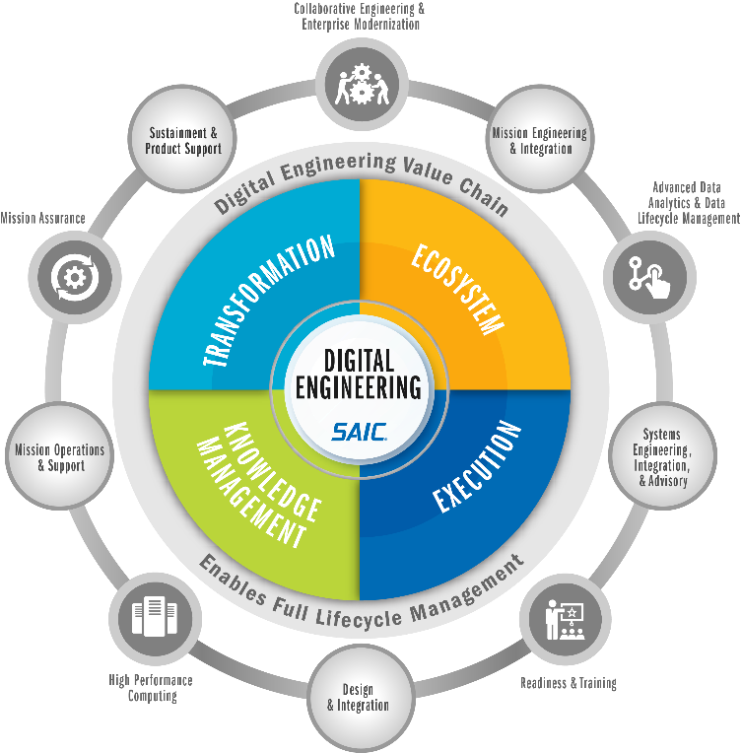
SAIC Digital Engineering
Online: saic.com/digital-engineering Email: digitalengineering@saic.com
MBSE
Lightning Round
33

Slide 33
SAIC Digital Engineering
SAIC DE Profile & Validation Rules: https://www.saic.com/digital- engineering-validation-tool
MBSE
Lightning Round
34

Slide 34

www.incose.org/iw2021/
MBSE
Lightning Round

